Slide 1
Today in science…
Sad news. The National Museum in Brazil burned down Sunday night.
20 million+ artifacts lost
Notes:
Incalculable loss.

Slide 2
Today in science…
Sad news. The National Museum in Brazil burned down Sunday night.
20 million+ artifacts lost
Notes:
They had just recently secured funding to install fire prevention systems, after years of their budget being reduced again and again.

Slide 3
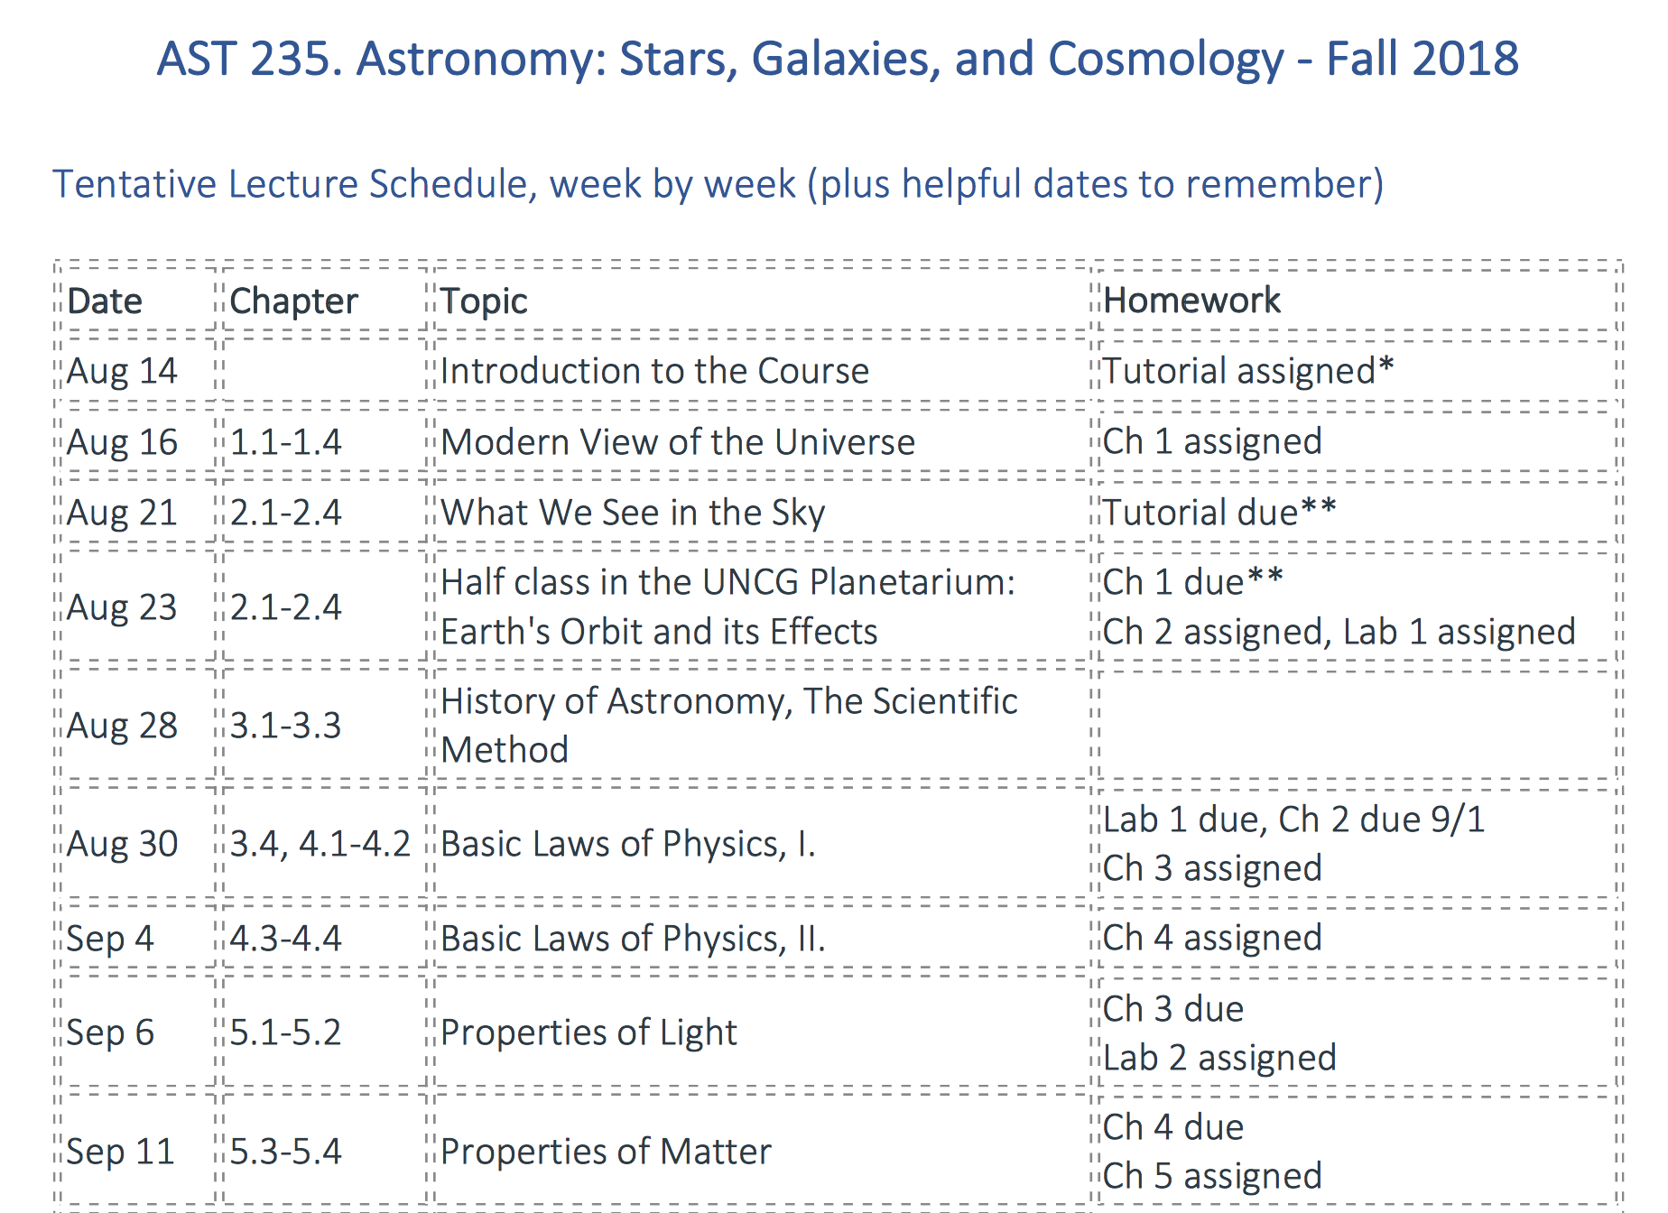
Brief syllabus recap: on homeworks & labs
The method to the assignments

Slide 4
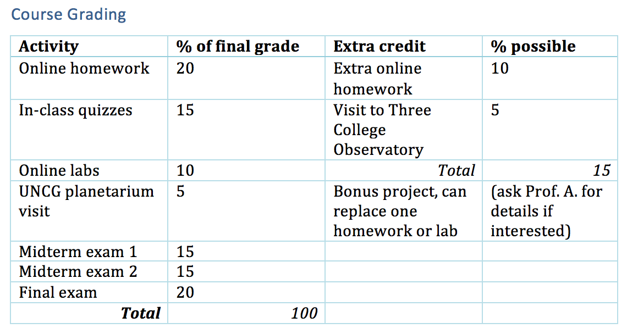

Brief syllabus recap: on homeworks & labs
Deep breaths! Lots of extra credit options. And,
I’ve added midterm exam review the days before exams.

Slide 5
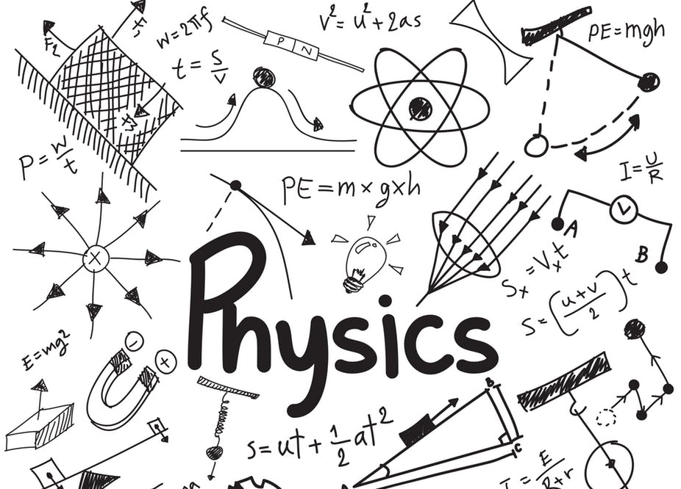
Making sense of the universe: fundamental laws of physics

Slide 6
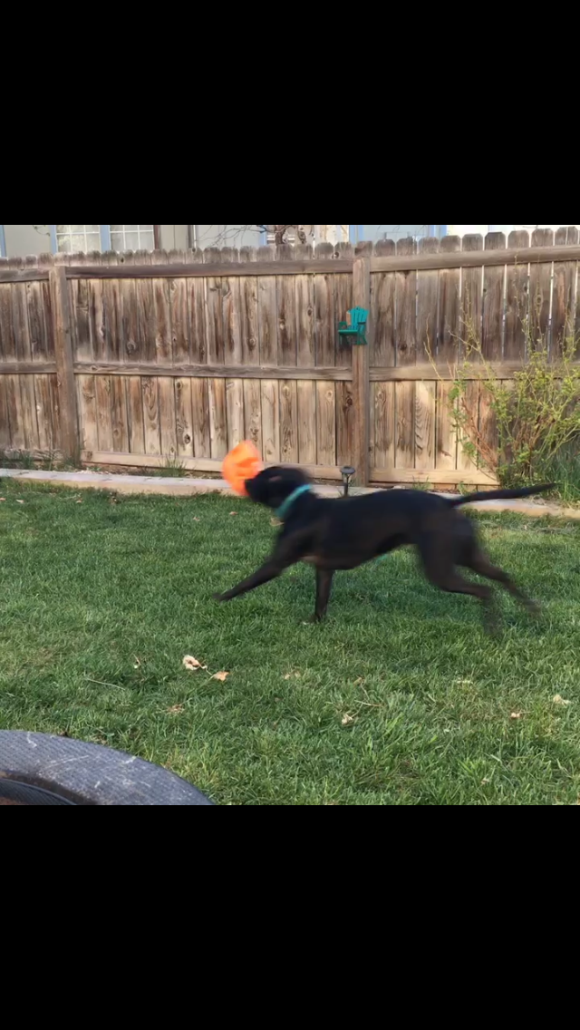
Last time…
We talked about describing motion
Position [x, y, z]
Speed – distance/time – m/s
Velocity, v – distance/time in [x, y, z] directions – m/s
Acceleration, a – change in velocity/time in [x, y, z] directions – m/s²
Acceleration due to gravity, g – on Earth, 9.8 m/s²
Momentum, p – mass * velocity – g*m/s
Angular momentum
Orbital
Rotational
New: ω = m * v * r
Notes:
ω is the greek letter omega (lower case). It’s used to denote angular momentum as distinct from linear momentum, p.

Slide 7
Last time…
Force: acts to change an object’s momentum
Net force: total sum of all forces working on an object
Torque changes an object’s angular momentum
Weight vs Mass: a force vs an inherent property
Free-fall and weightlessness: absence of force acting against downward weight

Slide 8
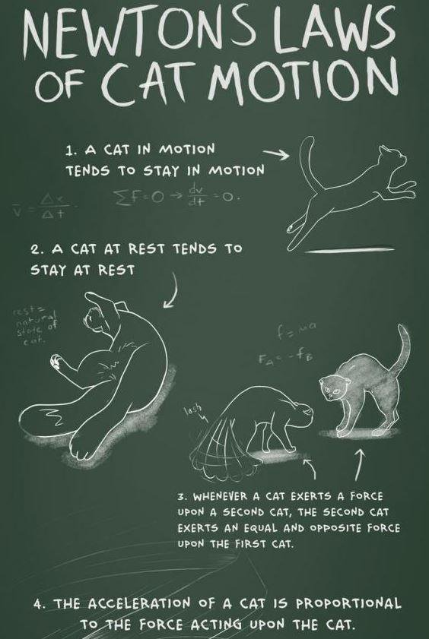
Newton’s laws
An object at rest will remain at rest unless acted upon by a force
F=ma
For any force, there is an equal and opposite force
Notes:
http://www.cakeburger.com/comic/cat-physics/

Slide 9
Evolution of ideas
Early observers collected the data later mathematicians and astrophysicists worked with later
Kepler came up with the framework of how:
How do the planets move in the sky?
Newton came up with the why
Newton’s laws, in combination with what we observe, give rise to what we call conservation laws
When a quantity is conserved, it means that over an entire system, the net amount of it stays the same

Slide 10
Conservation laws in astronomy: momentum
Conservation of momentum
Recall Newton’s third law: for every force, there’s an equal and opposite force
Recall also: a force is something that acts to change an object’s momentum
Upon impact, momentum is transferred from one object to another
Notes:
Something we observe here on Earth: conservation of linear momentum; that is to say, momentum acting in a straight path

Slide 11
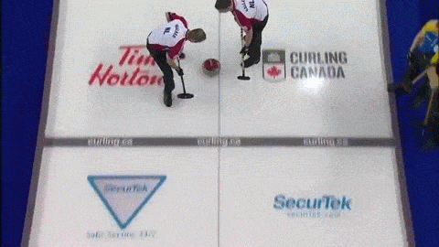
Conservation of momentum
Notes:
The book gives you an example of playing pool- curling is another good example, when the stones impact each other

Slide 12
Conservation of momentum
p=0
pow!
p1
decelerating
accelerating
p1
p=0
Notes:
Let’s break down one of those impacts…

Slide 13
Conservation of momentum
Notes:
The book gives you an example of playing pool- curling is another good example, when the stones impact each other

Slide 14
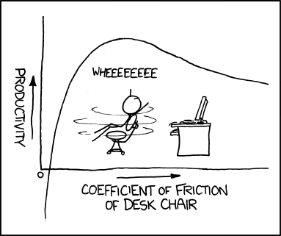
Conservation laws in astronomy: angular momentum
Conservation of angular momentum (recall: ω = m * v * r)
Rotational
Notes:
https://xkcd.com/815/
As figure skater’s radius, r, decreases, to conserve angular momentum, her rotational velocity must increase

Slide 15
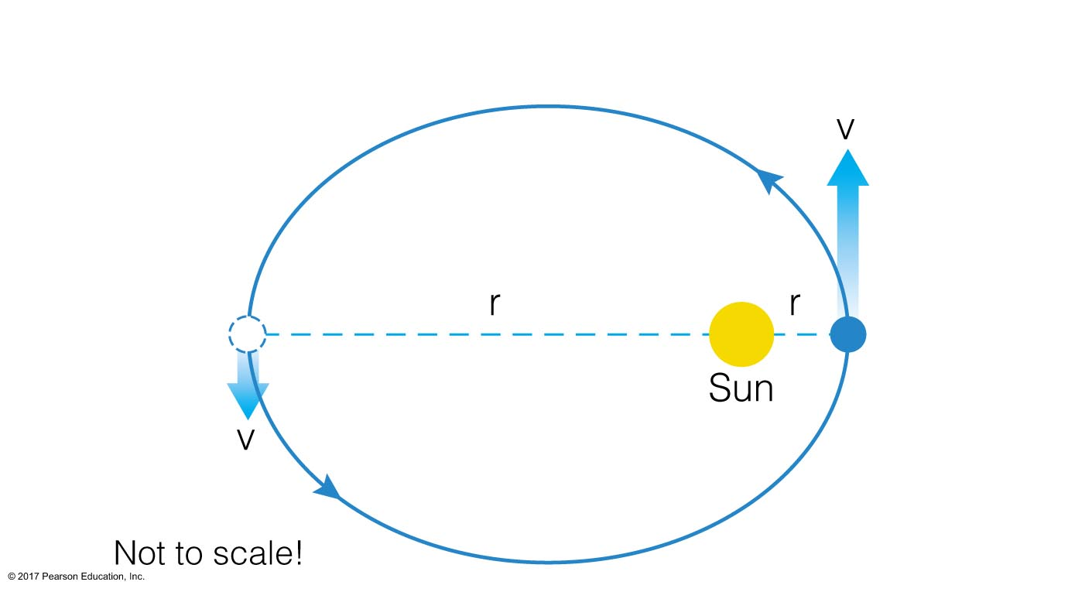
Conservation laws in astronomy: angular momentum
Conservation of angular momentum (recall: ω = m * v * r)
Rotational
Orbital
Newton’s 1st law: if no force is acting on the orbiting planet, it will keep on orbiting
Kepler saw orbital speeds changing, deduced elliptical orbits
its angular momentum is conserved
Notes:
We see this in the observations Kepler’s laws were built from
Kepler’s second law: the path of the planet’s orbit sweeps out equal areas for equal time

Slide 16
Energy
Energy is a property that enables something to do work
When a force acts to move an object a certain distance, it has done work
Work = force * distance
For astronomy, important types of energy:
Kinetic
Radiative
Potential
Affiliated conservation law: energy is not created or destroyed
Notes:
We’ll talk a lot about radiative energy in chapter 5

Slide 17
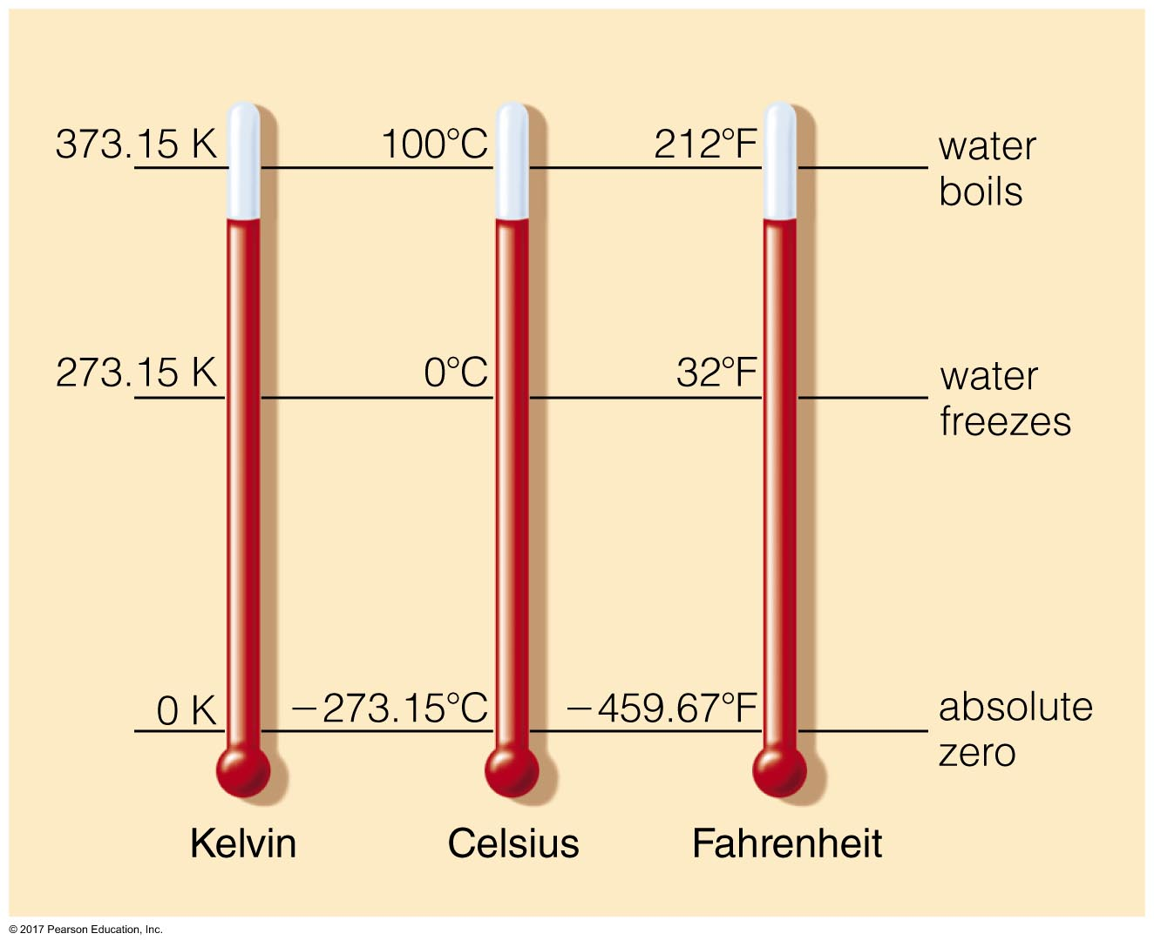
Kinetic energy
The energy of a moving object: ½ mv²
Important form of kinetic energy for us: thermal energy
Kinetic energy of atoms or molecules in a substance
Temperature: measures the average kinetic energy
Temperature tells us which way energy will move when two systems come into contact
Rate of energy flow depends on density
Absolute zero (Kelvin): thermal energy is 0
Notes:
The book gives a good example of a boiling pot of water vs an oven. The oven may be hotter, meaning the particles have higher average kinetic energy, but there are fewer of them than say, in a pot of boiling water.

Slide 18
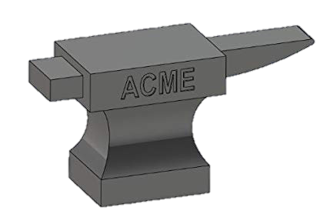
Potential energy
Potential energy is the capacity of something to do work
Example: if Wile E. Coyote is holding an anvil over a cliff, about to drop it, its potential energy depends on
The mass of the anvil
The acceleration due to gravity
The height of the cliff
PE = m*g*h
m
g
h

Slide 19
Gravitational potential energy
Notes:
Gravitational potential energy decreases the smaller the protostellar cloud gets
Thermal energy increases because density is increasing; the star forms in the middle, getting heated up from conversion of potential to kinetic energy
Due to conservation of angular momentum, we think material speeds up as it collapses
http://faculty.virginia.edu/skrutskie/ASTR1210/notes/ssrecip.html

Slide 20
Conservation of energy
Energy is not created or destroyed, it simply changes form
Example: you raise your hand to stifle a yawn
Your muscles exerted energy to perform the mechanical action of raising your hand
The energy your muscles used came from what you ate for breakfast
What you ate for breakfast got its energy from sunlight, one way or another
The sun is radiating energy in the form of light that came from fusing H atoms at its core, converting mass into energy
H atoms came from the big bang, which was a conversion of energy into mass

Slide 21
Universal law of gravitation
Newton, not content to stop at laws of motion, calculus, optics, etc… carried on to develop a framework for understanding gravity
Every mass attracts every other mass through a force called gravity
the strength of the force of gravity is directly proportional to the product of those two masses
the strength of the force of gravity decreases as the square of the distance between the two masses’ centers
F_{g} = G*M₁*M₂ / d²
Notes:
Note the big G- this is a universal constant, not to be confused with the little g for acceleration due to gravity on earth

Slide 22
Universal law of gravitation
F_{g} = G*M₁*M₂ / d²
Say M₁ = M₂ ; F_{g} = GM₂²/d²
Make M₁ = 0.5 M₂ ; F_{g} = GM₂²/2d²
If M₁ = M₂, but d is now doubled…
F_{g} = GM₂²/(2d)² = GM₂²/4d²
Strength of the force of gravity is
Directly proportional to the product of the masses- they’re in the numerator, and ^1 power
Inversely proportional to the square of the separation of the objects (d is in the denominator, and ^2)
Notes:
Examples of what would happen to the force of gravity between two objects if their masses or separation changed

Slide 23
Kepler’s laws and Newton’s laws
Kepler found the how, Newton found the why
Planets travel in elliptical orbits around the Sun
This is a natural consequence of Newton’s law of gravitation: both bodies are orbiting the center of mass of the Sun+planet system
x
Notes:
Exaggerated for effect…

Slide 24
Kepler’s laws and Newton’s laws
Kepler found the how, Newton found the why
Planets travel in elliptical orbits around the Sun
Planets cover equal areas in equal time along their orbits
Conservation of angular momentum

Slide 25
Kepler’s laws and Newton’s laws
Kepler found the how, Newton found the why
Planets travel in elliptical orbits around the Sun
Planets cover equal areas in equal time along their orbits
Planets’ orbital periods and semimajor axis radii are related as p² = a³
Planets experience less force due to gravity farther away from the Sun, and they move more slowly (F_{g} ~ 1/d²)

Slide 26
Beyond Kepler’s laws
Planets aren’t the only bodies that travel in elliptical orbits
So do moons
And asteroids
Ellipses aren’t the only kinds of orbits
Unbound parabolic orbits
Unbound hyperbolic orbits
Knowing orbital parameters, we can now calculate masses of orbiting bodies using the universal law of gravitation
Notes:
This is the cone Neil deGrasse Tyson was talking about in the video last week

Slide 27
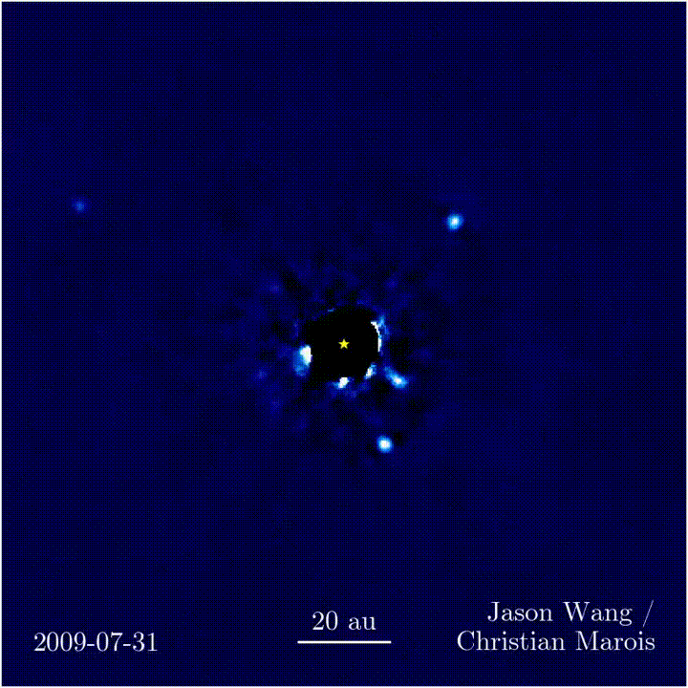
Beyond Kepler’s laws
Newton applied law of gravitation universally
Notes:
https://www.forbes.com/sites/startswithabang/2017/01/30/watch-four-gas-giants-in-orbit-around-another-star-for-the-first-time/

Slide 28
Orbital energy & gravitational encounters
A body’s total orbital energy is the sum of its kinetic energy (energy of motion, related to speed) and gravitational potential energy (dependent upon distance)
These components vary throughout the planet’s orbit, but the total energy is conserved
A close pass between a planet and a body (a comet, a satellite, another planet) can exchange orbital energy
The change in energy is almost negligible for the larger body

Slide 29
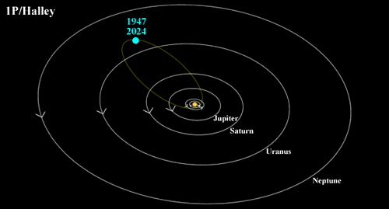
Orbital energy & gravitational encounters

Slide 30
Comet shenanigans
Stardust mission
Flew into coma of comet Wild 2 to collect material comet was outgassing
Deep Impact
Dropped a refrigerator-sized impactor onto comet Tempel 1 to see what would come out
Notes:
https://arstechnica.com/science/2013/09/deep-impact-probe-down-and-out-ice-back-for-maybe-more/

Slide 31
Atmospheric drag & escape velocity
Back to orbital energy considerations…
Orbital energy will be conserved, unless a force acts to change it
Atmospheric drag can reduce orbital energy, causing satellites’ trajectories to change
This could be bad: satellites we launch need to overcome/get far enough away to be safe
This could be good/interesting: planets in the outer solar system may have captured a lot of moons this way
As you increase its orbital energy, body will get farther and farther away
At some velocity, body can entirely leave its bound orbit: escape velocity

Slide 32
Tidal effects
The Earth’s rotation makes it an oblate spheroid shape
Centrifugal forces push outward, most at the equator
From N->S poles, Earth’s diameter is 12,713 km
Around Equator, Earth’s diameter is 12,756 km!
Gravitational forces between the Earth and the Moon also add to Earth’s bulge (~1m in water, ~30cm in rock) as do gravitational forces between the Earth and the Sun (about half as much as the Moon’s effect)
N
S
Notes:
http://www.slate.com/blogs/bad_astronomy/2008/09/08/ten_things_you_dont_know_about_the_earth.html
Also
http://www.slate.com/blogs/bad_astronomy/2006/08/30/when_i_say_centrifugal_i_mean_centrifugal.html

Slide 33
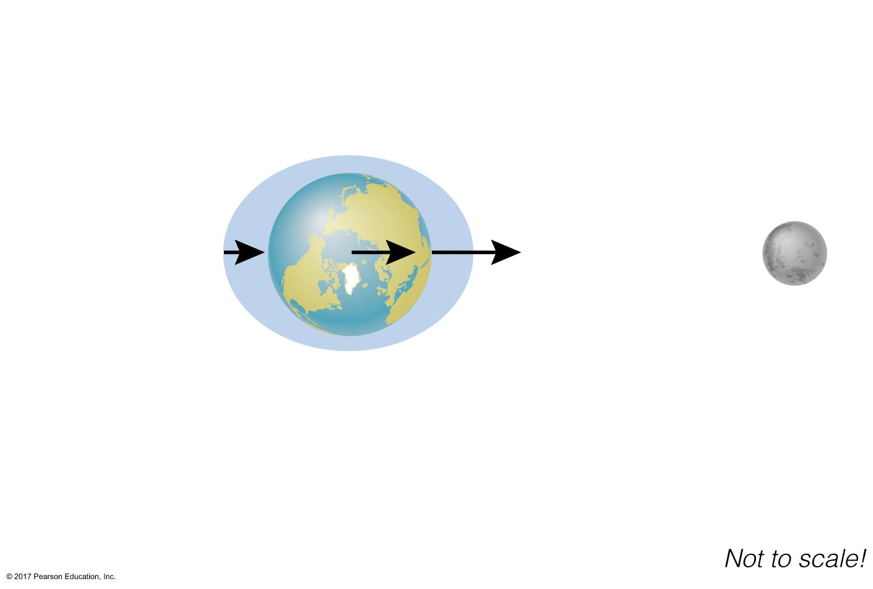
Tidal effects
Amount of bulge depends on distance (it’s a gravitational effect!)
Sun and Moon can work together or against each other, depending on where Earth, and Moon are in orbits

Slide 34
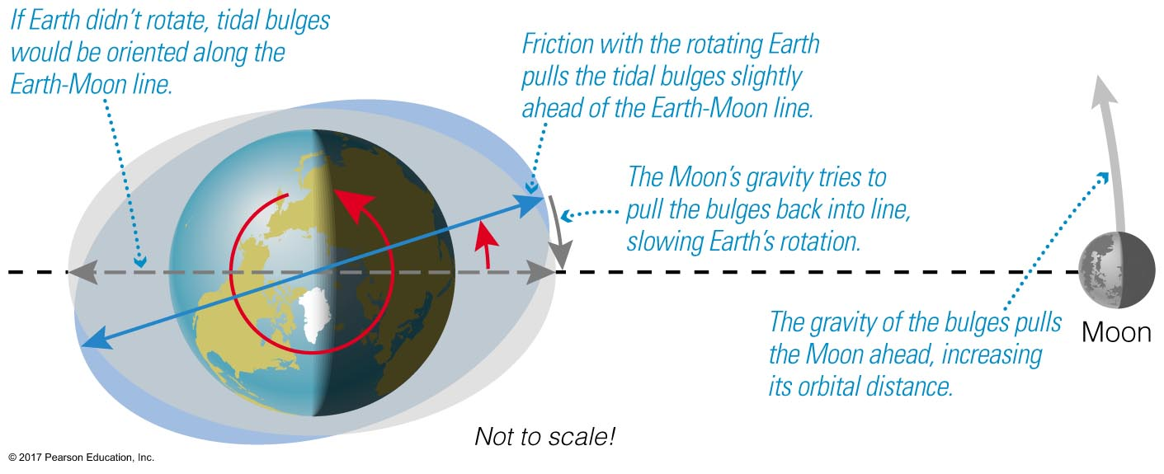
Tidal friction
Gravitational force between Earth and Moon has raised a bulge on Earth
Earth is rotating, so a tug-of-war begins as bulge starts to outpace the Moon

Slide 35
The moon’s synchronous rotation
As the Moon is creating tidal effects on Earth, so the Earth has also done to the Moon
Moon gains orbital angular momentum from the Earth as it slows earth down
Moon’s distance from Earth starts to grow (conservation of angular momentum)
The Moon used to be a lot closer to us than it is now
It also likely rotated faster
2014: Scientists were able to measure a “lunar body tide,” a 20 inch bulge in the Moon’s surface due to Earth’s gravitational pull
Notes:
https://www.space.com/26246-lunar-tide-seen-from-space.html

Slide 36
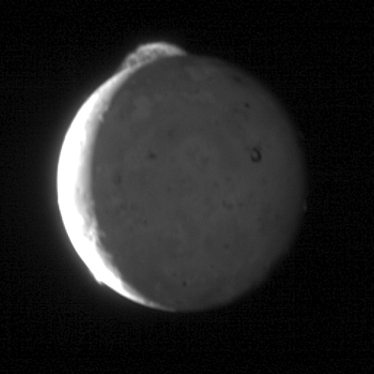
Tidal effects on other worlds
Synchronous rotation of moons is common
Tidal bulging also common on other moons
the more massive the planet, the stronger the force
Jupiter’s moon Io is volcanically active from being squeezed by Jupiter, Ganymede, and Europa (numerous tidal bulges!)
Notes:
Video from New Horizons spacecraft while flying by

Slide 37
Why do all objects fall at the same rate?
We can understand this using two laws Newton discovered.
F_{g} = G M_{Earth} M_{ball}
R_{Earth}²
F = m_{ball}a
Set them equal to each other…
G M_{Earth} M_{ball} = m_{ball} a
R_{Earth}²
… = g

